Slide 1
Experiment Planning

Slide 2

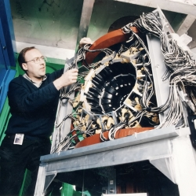
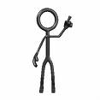
Scope
Before an experiment
Is idea feasible?
Facility
User
Beamline
scientist

Slide 3
Scope
During an experiment
Levels of run control
Decision making tools
Same requirements?
Facility
User
Beamline
scientist

Slide 4
Software
McStas simulations for experiment planning
Other software (e.g. Mkscript)

Slide 5
5 year plan
Plan for computation simulations also?

